Slide 1
Budget patients, not dollars
HOW THE BUDGET IS BUILT
Patient days Volume driver
MICROSOFT FABRIC · PLANNING IN FABRIC IQ
×
Hours per patient day Staffing driver
×
Rate per worked hour Rate driver
Driver-based operational planning for Contoso Health
=
Labor dollars Output
Demo walkthrough · Synthetic 300-bed hospital dataset
Notes:
This deck walks through the Contoso Health planning demo: why traditional hospital budgets struggle to explain variances, how the driver-based model is built in Microsoft Fabric, what each column in the planning sheet means, and what the scenarios show. All data is synthetic.

Slide 2
“Volume was up” explains only half the overrun
Q2 2026 LABOR VARIANCE · MED-SURG 3 WEST
$51,295
WHERE THE OVERRUN CAME FROM
55%
17%
28%
Volume $28,328
28.3 patients a day against 27.4 planned
Owner: strategy and access
Med-Surg 3 West ran over its direct-care labor budget in Q2 2026 (Apr–Jun).
Staffing efficiency $8,673
8.58 hours per patient day against a target of 8.50
Owner: nursing leadership
Higher census explained 55%. Almost half came from causes nobody was discussing.
Rate $14,294
$42.83 per worked hour against $42.19, from agency and overtime
Owner: HR and workforce
Contoso Health · Synthetic demo data
Notes:
Open with the familiar explanation in monthly reviews: volume was up. For Med-Surg 3 West in Q2 2026 that was true, but it explained only 55 percent of the 51,295 dollar overrun. The rest split between staffing above target and paying premium rates. A traditional budget cannot show this split; a driver-based one can. Hospital-wide, agency labor ran 1.29 million dollars over budget from January to August 2026, 66 percent above plan.

Slide 3
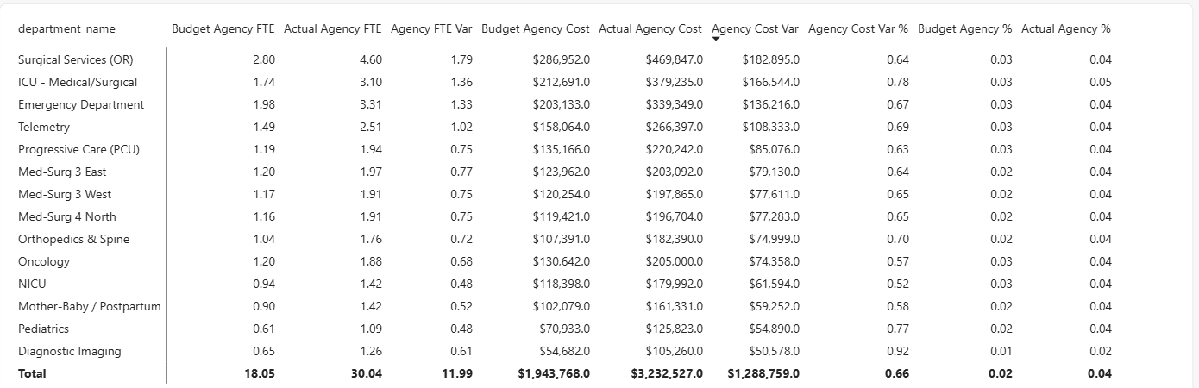
Hospital-wide, agency labor ran $1.29M over budget
AGENCY LABOR · HOSPITAL-WIDE · JAN–AUG 2026
18.05 → 30.04 agency FTEs
$1.94M → $3.23M
Every unit over plan
Budgeted against actual, Jan–Aug 2026
Agency cost, 66% over plan
Surgical Services, ICU and the ED lead the overrun
Contoso Health · Synthetic demo data
Notes:
This is the variance view built in Power BI on the same semantic model. Every department ran agency labor above plan, which is the problem the plan has to address. Volume and revenue came in above plan, but labor cost rose faster because of agency and overtime.

Slide 4

Forecast the patients, and let everything else follow
THE APPROACH · DRIVER-BASED PLANNING
Patient days
Nursing hours
Paid FTEs
Labor cost
Predicted from 32 months of history
× hours each patient day needs (HPPD)
÷ paid hours per nurse
× wage rate and benefits
Owner: strategy
Owner: nursing
Owner: HR
Owner: finance
Each link is a simple rule that one team owns. Change the volume forecast, and every downstream number recalculates for every unit.
Contoso Health · Synthetic demo data
Notes:
The core idea: costs are driven by patients, not by last year's spending. So forecast patient days, then derive nursing hours, FTEs and cost with simple rules. Each rule has an owner, which is what makes variances explainable later.

Slide 5

One Fabric platform, from source data to plan
ARCHITECTURE · MICROSOFT FABRIC
Source data
Lakehouse
Semantic model
Planning sheet
Intelligence sheet
Census, timekeeping, payroll, general ledger
Delta tables in OneLake
Star schema, relationships, measures
Forecast, Predict, formulas, scenarios
Actual vs budget variance
The census behind the plan is the same census in every report. No exports, no copies, no reconciling spreadsheets.
Contoso Health · Synthetic demo data
Notes:
The architecture. Source data lands in a Lakehouse as Delta tables. A semantic model defines relationships and measures once. Planning in Fabric IQ reads that model directly: the planning sheet holds the forecast, formulas and scenarios, and the intelligence sheet shows variance. Everything stays in one governed platform.

Slide 6
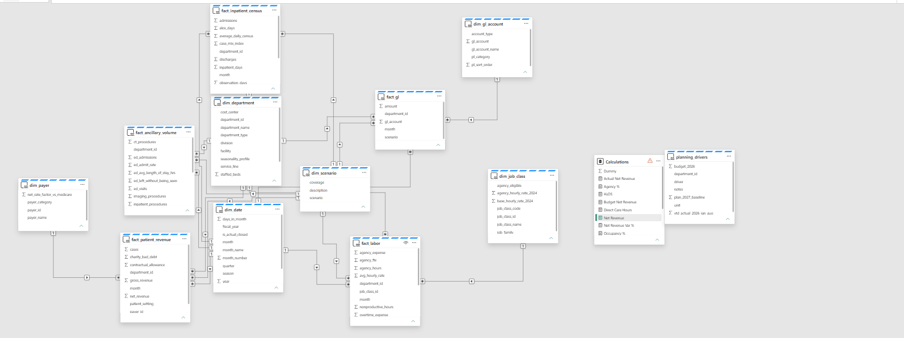
One semantic model feeds every report and plan
ARCHITECTURE · SEMANTIC MODEL
Six dimensions: date, department, job class, payer, GL account and scenario
Five fact tables: census, ancillary volume, labor, patient revenue and general ledger
Direct Lake reads the Lakehouse tables directly, with no import or copy
Measures are defined once in a Calculations table and reused everywhere
Contoso Health · Synthetic demo data
Notes:
The semantic model sits on the Lakehouse in Direct Lake mode. Relationships are one-to-many from dimensions to facts, single direction. The planning sheet connects to this same model, so plan, actuals and reports never drift apart.

Slide 7
Five steps to a driver-based plan
WALKTHROUGH · OVERVIEW
1
Filter to actuals
Scenario = Actual and inpatient units only, so budget rows never mix into history
2
Create the forecast measure
Model › Forecast: the container for Sep 2026 – Dec 2027, linked to actuals for past months
3
Run Predict
MSTL trend decomposition with 12-month seasonality, trained on Jan 2024 – Aug 2026
4
Add staffing formulas
Nursing hours, paid FTEs and labor cost, calculated month by month
5
Simulate scenarios
Model › Scenario: +10% and −5% volume, then compare side by side
Contoso Health · Synthetic demo data
Notes:
The build sequence in the planning sheet. The most common mistake is step one: every fact table holds both actual and budget rows, so without the Actual filter, 2026 double counts and Predict learns a false jump. The forecast measure must exist before Predict, because Predict needs editable future periods to write into.

Slide 8
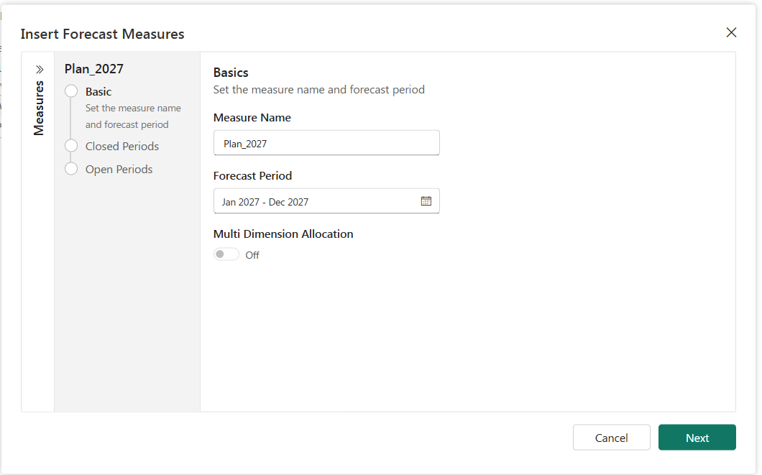
Step 1: create the forecast measure
WALKTHROUGH · STEP 1
1
Basic
Name the measure and set the period: Sep 2026 – Dec 2027
2
Closed periods
Link to Patient Days, so past months show actuals
3
Open periods
Left editable, ready for Predict to fill
Required first: Patient Days is read-only, and 2027 does not exist in the data. The forecast measure creates the future months.
Contoso Health · Synthetic demo data
Notes:
Model tab, Forecast. Starting the forecast in September 2026 means it picks up exactly where actuals end. The screenshot shows the dialog's basic step; closed and open periods follow.

Slide 9
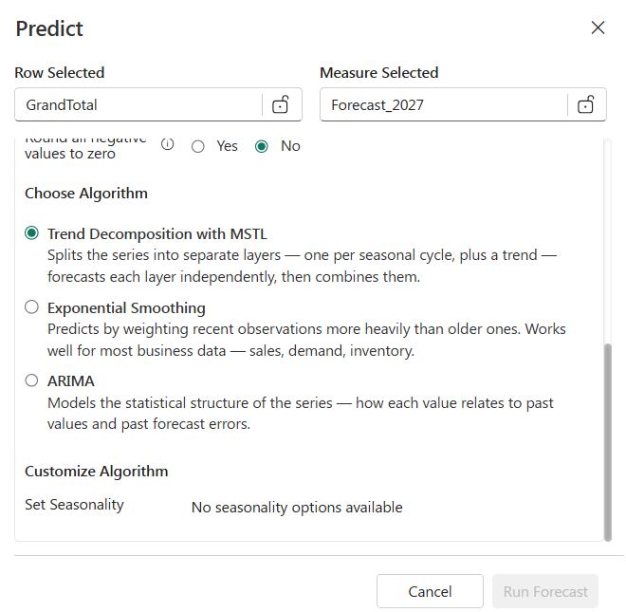
Step 2: let Predict learn from 32 months of history
WALKTHROUGH · STEP 2
1
Pick the algorithm
Trend Decomposition with MSTL separates the trend from each seasonal cycle
2
Set the ranges
History Jan 2024 – Aug 2026; forecast Sep 2026 – Dec 2027
3
Use monthly columns
With yearly columns there is no seasonality to find, so Run stays disabled, as in this screenshot
4
Run and save
Predict writes into the forecast measure; actuals are never changed
Contoso Health · Synthetic demo data
Notes:
This screenshot was taken on a yearly sheet, which is why it says no seasonality options are available and Run Forecast is greyed out. Switching columns to year, quarter, month fixed it and enabled 12-month seasonality.

Slide 10
Column guide: the volume measures
REFERENCE · VOLUME MEASURES
Column | What it means | Source | ICU example
Patient Days | Actual patient days. One patient in a bed for one day is one patient day, including observation patients. Blank for 2027. | Semantic model, actuals only | 7,040 in 2024
Target HPPD | Hours per patient day: the nursing hours each patient day needs. Sicker patients need more. | Unit target set by nursing leadership | 17.0 hours (Med-Surg: 8.5)
Forecast 2027 | One continuous patient-day line. Actuals for Jan 2024 – Aug 2026, Predict’s forecast for Sep 2026 – Dec 2027. | Forecast measure filled by Predict | 7,300 in 2027
Contoso Health · Synthetic demo data
Notes:
Patient Days is the raw actual, so it is empty for 2027. Forecast 2027 carries the full line from history into the plan, which is why its past values match Patient Days exactly. Target HPPD varies a lot by unit: the ICU needs about twice the nursing hours per patient day that Med-Surg does. Note that at quarter and year level the sheet sums HPPD, so read it at month level.

Slide 11

Column guide: the staffing measures
REFERENCE · STAFFING MEASURES
Column | What it means | Formula | ICU 2027
Nursing Hours | Direct-care nursing hours needed to cover the forecast volume | Forecast 2027 × Target HPPD | ≈124,100
Paid FTE | Full-time staff needed on payroll, averaged over the period, with a buffer for PTO | Nursing Hours ÷ 0.885 ÷ 173.33 | ≈67
Labor Cost | What those staff cost, benefits included, at 2027 rates | Nursing Hours ÷ 0.885 × $41.91 × 1.285 | ≈$7.6M
Hours and cost add up across months. FTEs average: twelve months of 67 FTEs is still 67 people.
Contoso Health · Synthetic demo data
Notes:
These three are formula measures in the planning sheet. They calculate month by month and then roll up, which is why the column aggregation settings matter: Sum for hours and cost, Average for FTEs. Labor cost uses 2027 wage rates for every year, so history shows what that volume would cost at next year's wages, not what the ledger recorded.

Slide 12
Four constants turn hours into people and dollars
REFERENCE · PLANNING CONSTANTS
0.885
173.33
$41.91
1.285
Worked share
Hours per FTE
Blended wage
Benefits load
11.5% of paid time goes to PTO, holidays and sick days
Paid hours in one month for one full-time person: 2,080 ÷ 12
Average hourly rate across RNs, LPNs and nursing assistants, 2027
Adds 28.5% for health, retirement and payroll taxes
The chain in one line: patient days × HPPD = nursing hours → ÷ hours per nurse = FTEs → × wage and benefits = cost.
Contoso Health · Synthetic demo data
Notes:
These constants come from the dataset's planning drivers. Each one has an owner and can become an editable driver row later, for example if HR wants to test a different wage increase or PTO rate.

Slide 13
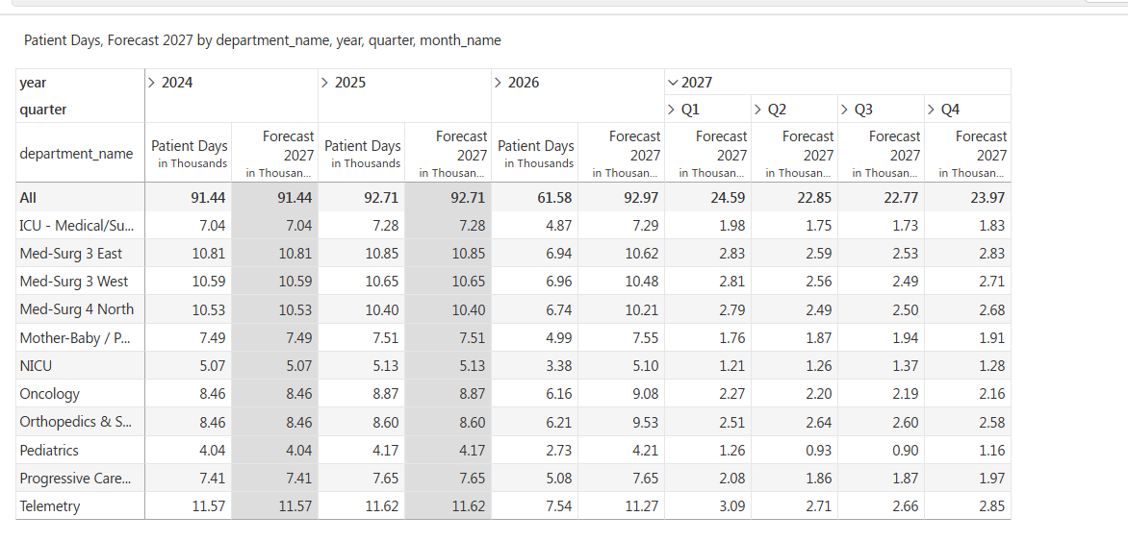
Predict forecasts 94,180 patient days for 2027
RESULTS · 2027 FORECAST
94,180
patient days across 11 inpatient units in 2027
Quarter | Patient days
Q1 · respiratory season | 24,590
Q2 | 22,850
Q3 | 22,770
Q4 | 23,970
Orthopedics climbs to 10,330, up from 8,600 in 2025: the model found the new surgeon group on its own.
Contoso Health · Synthetic demo data
Notes:
The clean forecast after filtering to actuals. 2026 as a full year comes to 92,970: 61,580 actual plus the predicted September to December. Mother-Baby eases as births decline; Pediatrics swings from 1,260 in Q1 to 900 in Q3.

Slide 14
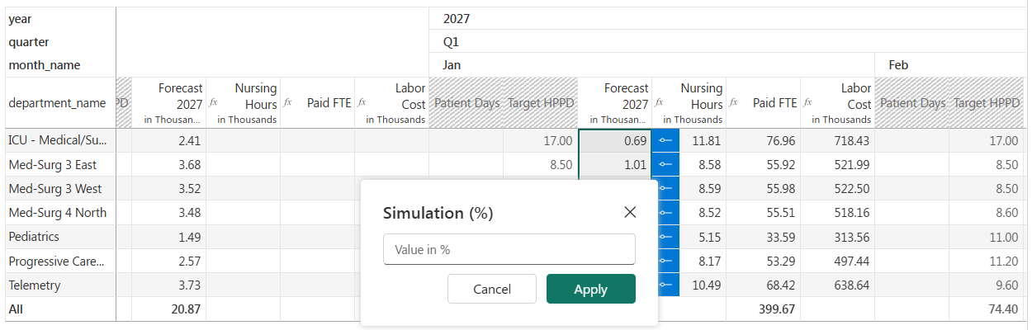
How a simulation works
SCENARIOS · HOW IT WORKS
1
Create a scenario tab
Model › Scenario: name it, choose Forecast 2027, Create
2
Select the cells
Shift + click a block; Ctrl + click to add more
3
Enter the increase once
20 means +20%. Applying twice compounds
4
Everything recalculates
Hours, FTEs and cost follow; changed cells carry a % tag
Contoso Health · Synthetic demo data
Notes:
Simulations only run on scenario tabs; the Base tab never changes. The number entered is an increase, not a share of base: 128 means plus 128 percent. Each change appears in the bar above the grid, where it can be removed individually.

Slide 15
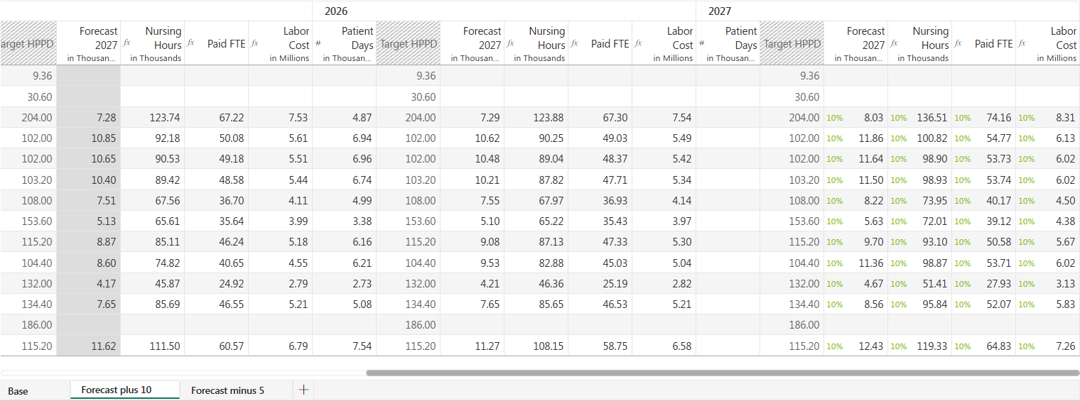
+10%: one change flows through every measure
SCENARIOS · +10% VOLUME
ICU: 7,300 → 8,030 patient days
124,100 → 136,510 hours
≈67 → 74.2 FTEs, $8.31M
Forecast 2027, +10%
Nursing hours follow automatically
ICU needs twice Med-Surg's hours per patient day
Contoso Health · Synthetic demo data
Notes:
The plus 10 percent tab. Only Forecast 2027 was simulated; nursing hours, FTEs and labor cost recalculated on their own. The ICU adds about 6.8 FTEs because it needs 17 hours per patient day against Med-Surg's 8.5.

Slide 16
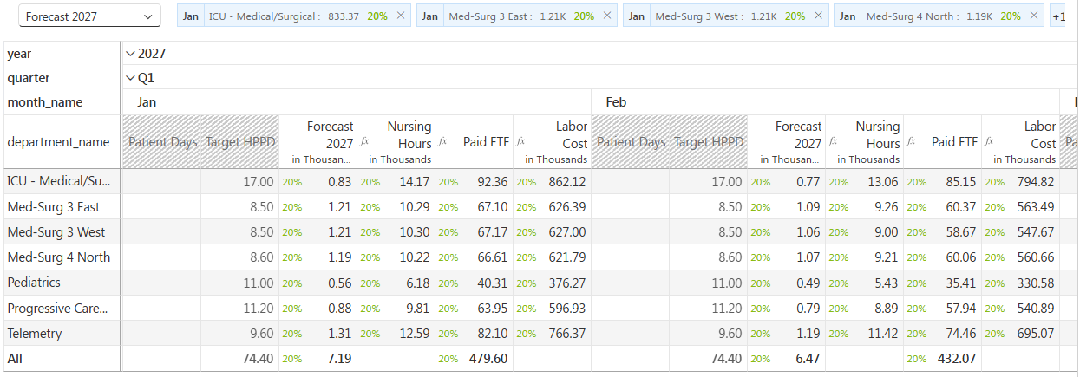
Respiratory surge: +20% on seven units, three winter months
SCENARIOS · RESPIRATORY SURGE
+3,420 patient days
≈76 extra FTEs a month
≈+$2.1M labor
Only 3.6% added to the year
Jan +80 · Feb +72 · Dec +76
Concentrated in Dec–Feb
Contoso Health · Synthetic demo data
Notes:
Seven units: the three Med-Surg units, ICU, Progressive Care, Telemetry and Pediatrics. Twenty-one cells simulated at plus 20 percent. Compared with the flat plus 10 percent, it adds far less volume over the year but concentrates about 75 extra nurses into three months: an agency and overtime question, not a hiring one.

Slide 17

The surge would push four units past their beds
SCENARIOS · BED CAPACITY
Unit, January 2027 | Patient days | Patients per day | Staffed beds | Occupancy
Med-Surg 3 East | 1,210 | 39 | 32 | ≈122%
Med-Surg 3 West | 1,210 | 39 | 32 | ≈122%
Telemetry | 1,310 | 42 | 36 | ≈117%
ICU | 833 | 27 | 24 | ≈112%
Not only a staffing problem: the hospital would be out of beds. Plan for overflow units, diversion and agency cover before winter.
Contoso Health · Synthetic demo data
Notes:
Occupancy calculated from the surge scenario's January patient days divided by beds times 31 days. A spreadsheet accepts any number; a driver-based plan shows when the plan cannot physically happen.

Slide 18
Four scenarios against one baseline
SCENARIOS · COMPARISON
2027, all inpatient units | −5% | Base | +10% | Respiratory surge
Patient days | 89,470 | 94,180 | 103,600 | 97,600
Nursing hours | ≈898,000 | ≈945,000 | ≈1,040,000 | ≈980,000
Paid FTE (average) | ≈488 | ≈514 | ≈565 | +76 in surge months
Labor cost | ≈$54.6M | ≈$57.5M | ≈$63.3M | ≈$59.6M
Same drivers, four answers. The surge adds the least volume, yet it is the hardest to staff, because it all lands in three months.
Contoso Health · Synthetic demo data
Notes:
Patient days come from the scenario tabs. Hospital-wide hours, FTEs and cost for the flat scenarios are estimates from each unit's forecast; confirm against the All row before presenting. Surge figures are the sum of the three simulated months.

Slide 19
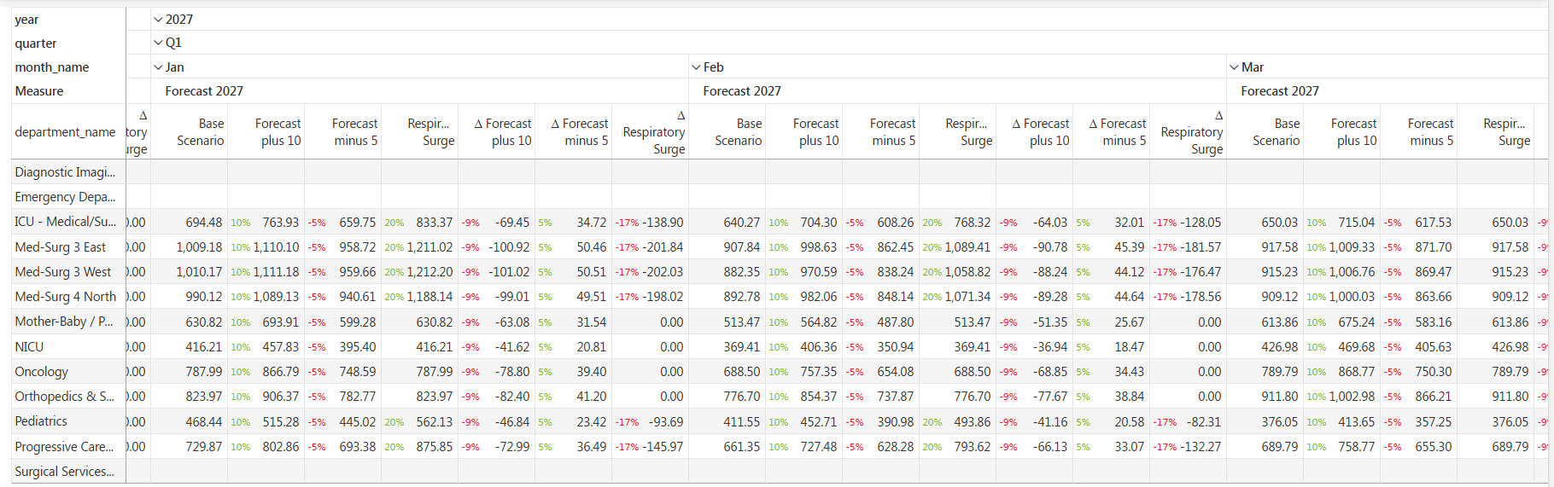

Reading the Compare view
SCENARIOS · COMPARE VIEW
Base Scenario: the forecast as Predict produced it
Forecast plus 10 / minus 5: base with volume raised or lowered
Δ columns: the difference between base and each scenario
Coloured tags: percentage difference from base, cell by cell
Δ is Base − Scenario, so +10% shows a negative delta. Flip it or hide the Δ columns.
Contoso Health · Synthetic demo data
Notes:
Model, Compare. The small coloured numbers are variance tags, not separate columns. For ICU January 2027, base is 694, plus 10 is 764, and the delta shows minus 69 because it is calculated as base minus scenario.

